Slide 1

Database Systems
Lecture 7

Slide 2
Lecture Agenda
Naming Conventions
Introduction to Keys
Oracle Data Types
Getting started with SQL
SQL Commands
Naming convention in SQL
Data Definition Language
CREATE command
Constraints and CREATE command

Slide 3
Naming conventions in ER models

Slide 4
Introduction
Importance of Naming Conventions: Naming conventions provide a standard way to name entities, attributes, and relationships, making the model more intuitive.
Enhances Readability and Understanding: Well-chosen names allow users and developers to quickly grasp the purpose of each element in the model, facilitating better communication and collaboration.

Slide 5
Entity Names
Use Nouns: Entities represent objects or concepts in the system. Using nouns (e.g., Customer, Order, Product) makes their purpose clear.
Form: While singular names are typically preferred for clarity, using plural forms can be appropriate in some contexts (e.g., in diagrams where entities are represented as collections).

Slide 6
Attribute Names
Descriptive Names: Attributes should clearly describe the data they hold. For example, FirstName is more informative than FN.
Format: To enhance readability, avoid spaces in names. Use camelCase (e.g., firstName) or underscores (e.g., first_name) to separate words, making the attributes easily recognizable.

Slide 7
Relationship Names
Use Verbs or Phrases: Relationships define how entities interact. Naming them with verbs (e.g., places, contains, belongs_to) helps clarify the nature of the interaction.
Direction: If relationships have a direction, indicate this clearly (e.g., Customer places Order), which can aid in understanding the flow of data.

Slide 8
Primary Keys
Naming: Primary keys uniquely identify each entity instance. A common practice is to prefix with ID (e.g., CustomerID) or use a combination of the entity name and ID for clarity.
Consistency: Consistent naming helps quickly identify primary keys across different entities.

Slide 9
Foreign Keys
Naming: Foreign keys reference primary keys in other entities. Including the referenced entity name in the foreign key (e.g., CustomerID in the Order entity) enhances clarity and indicates relationships.

Slide 10
Avoid Abbreviations
Keep Names Clear: While abbreviations can save space, they may reduce clarity. Full, descriptive names are preferable.
Enhance Readability: Avoid unnecessary abbreviations to maintain readability, making it easier for others to understand the model without prior knowledge.

Slide 11
Consistency
Maintain Consistent Naming Patterns: Adopting a uniform approach to naming throughout the model fosters familiarity and reduces confusion.
Ensures Clarity and Ease of Understanding: Consistent conventions allow anyone working with the model to quickly interpret the relationships and attributes.

Slide 12
Introduction to keys

Slide 13
Types of Keys in Relational Model (Candidate, Super, Primary, Alternate and Foreign)
Keys are one of the basic requirements of a relational database model. It is widely used to identify the tuples(rows) uniquely in the table. We also use keys to set up relations amongst various columns and tables of a relational database.

Slide 14
Different Types of Database Keys
Candidate Key
Primary Key
Super Key
Alternate Key
Foreign Key
Composite Key

Slide 15
Candidate Key
The minimal set of attributes that can uniquely identify a tuple is known as a candidate key. For Example, STUD_NO in STUDENT relation.
It is a minimal super key.
It is a super key with no repeated data is called a candidate key.
The minimal set of attributes that can uniquely identify a record.
It must contain unique values.
It cannot contain NULL values.
Every table must have at least a single candidate key.
A table can have multiple candidate keys but only one primary key.
The value of the Candidate Key is unique.
There can be more than one candidate key in a relationship.
One of the candidate keys is selected as the primary key.

Slide 16
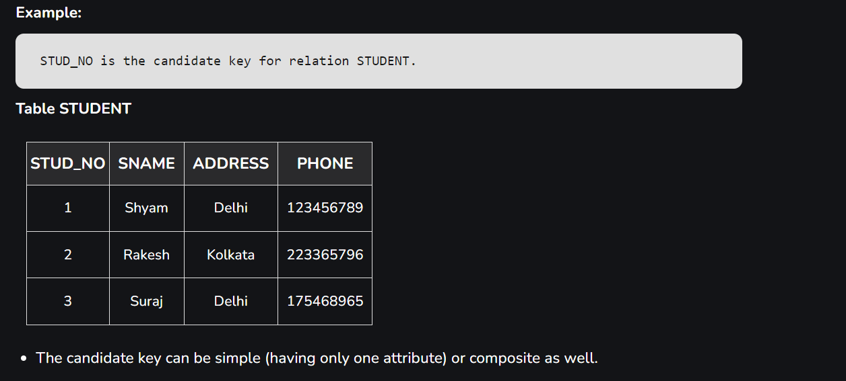

Slide 17
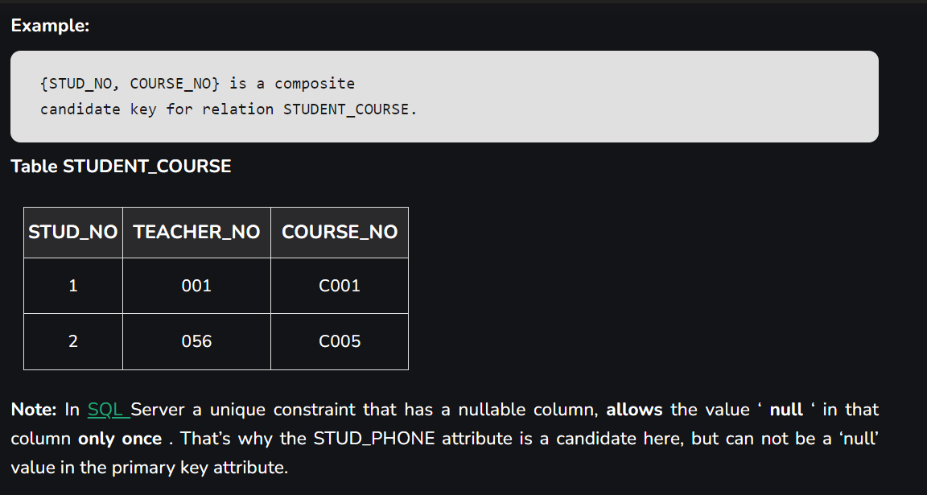

Slide 18
Primary Key
There can be more than one candidate key in relation out of which one can be chosen as the primary key. For Example, STUD_NO, as well as STUD_PHONE, are candidate keys for relation STUDENT but STUD_NO can be chosen as the primary key (only one out of many candidate keys).
It is a unique key.
It can identify only one tuple (a record) at a time.
It has no duplicate values, it has unique values.
It cannot be NULL.
Primary keys are not necessarily to be a single column; more than one column can also be a primary key for a table.

Slide 19
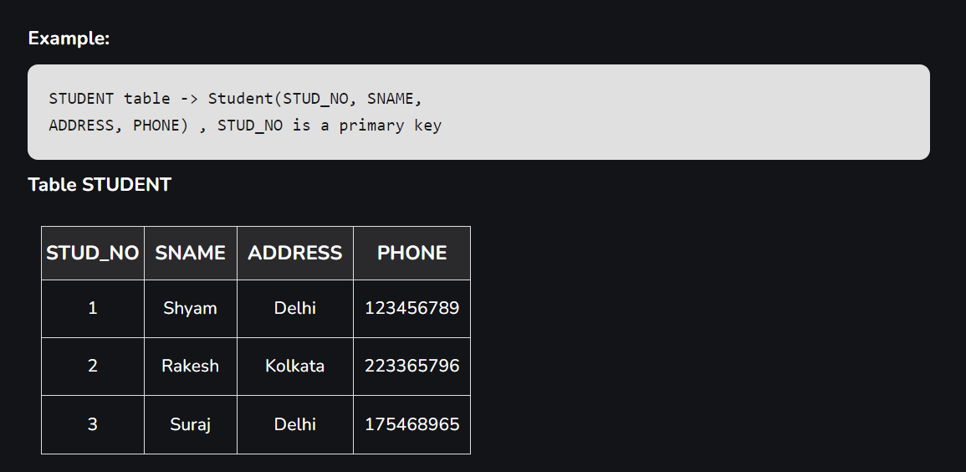

Slide 20
Super Key
The set of attributes that can uniquely identify a tuple is known as Super Key. For Example, STUD_NO, (STUD_NO, STUD_NAME), etc. A super key is a group of single or multiple keys that identifies rows in a table. It supports NULL values.
Adding zero or more attributes to the candidate key generates the super key.
A candidate key is a super key but vice versa is not true.
Super Key values may also be NULL.

Slide 21
Candidate key vs Super Key
Superkey: Any set of attributes that can uniquely identify a record in a table. It can have additional attributes that aren't necessary for uniqueness.
Candidate Key: A minimal superkey; it has no redundant attributes. Removing any attribute from a candidate key would mean it no longer uniquely identifies records.
In summary, every candidate key is a superkey, but not every superkey qualifies as a candidate key due to the presence of unnecessary attributes.

Slide 22
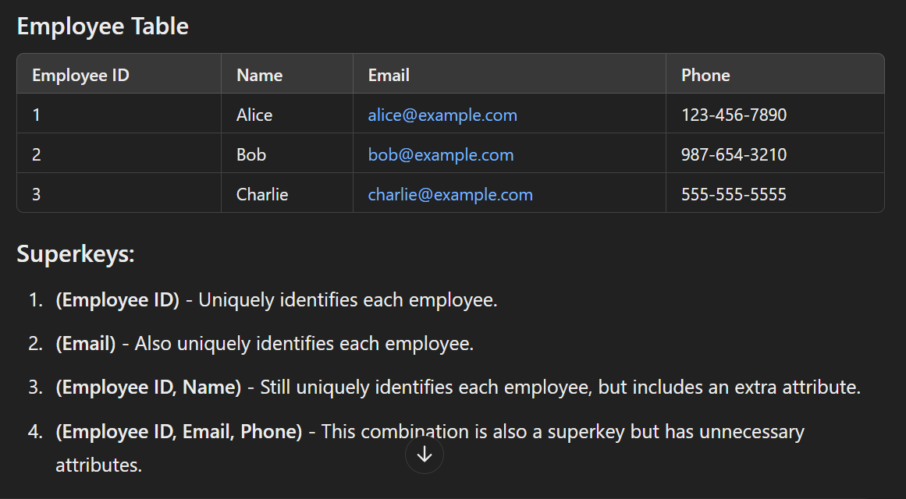
Example:

Slide 23
Example..cont
Candidate Keys:
(Employee ID) - This is a minimal superkey.
(Email) - This is also a minimal superkey.
Not Candidate Keys:
(Employee ID, Name) - While this is a superkey, it is not a candidate key because it includes an unnecessary attribute (Name).
(Employee ID, Email, Phone) - This is a superkey but not a candidate key for the same reason.

Slide 24
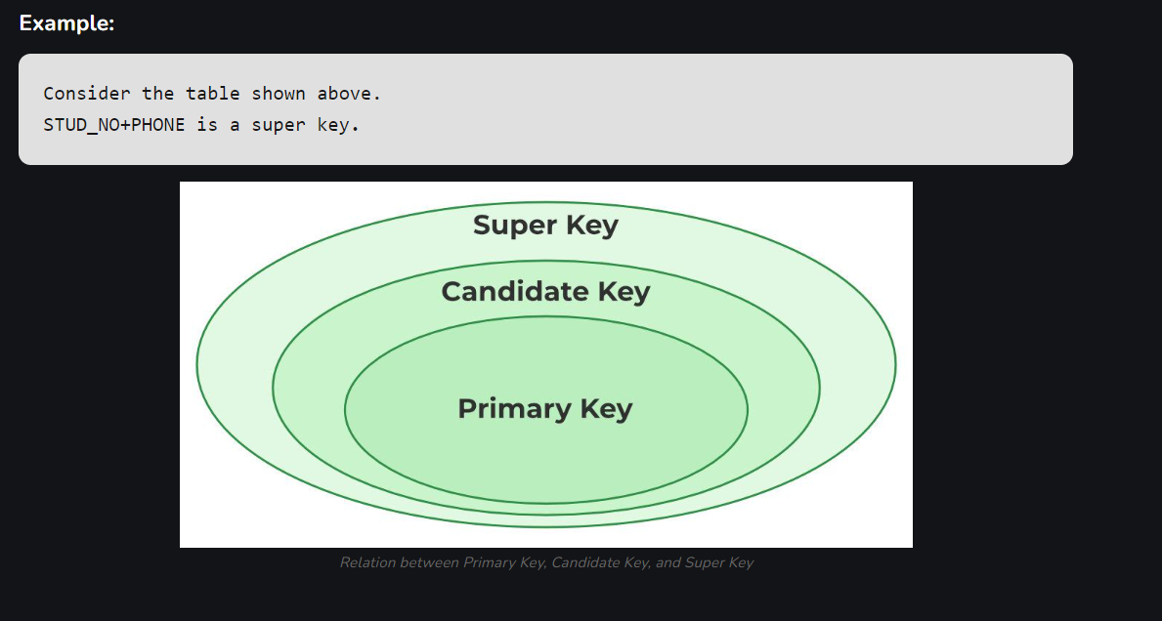

Slide 25
Alternate Key
The candidate key other than the primary key is called an alternate key .
All the keys which are not primary keys are called alternate keys.
It is a secondary key.
It contains two or more fields to identify two or more records.
These values are repeated.
Eg:- SNAME, and ADDRESS is Alternate keys

Slide 26
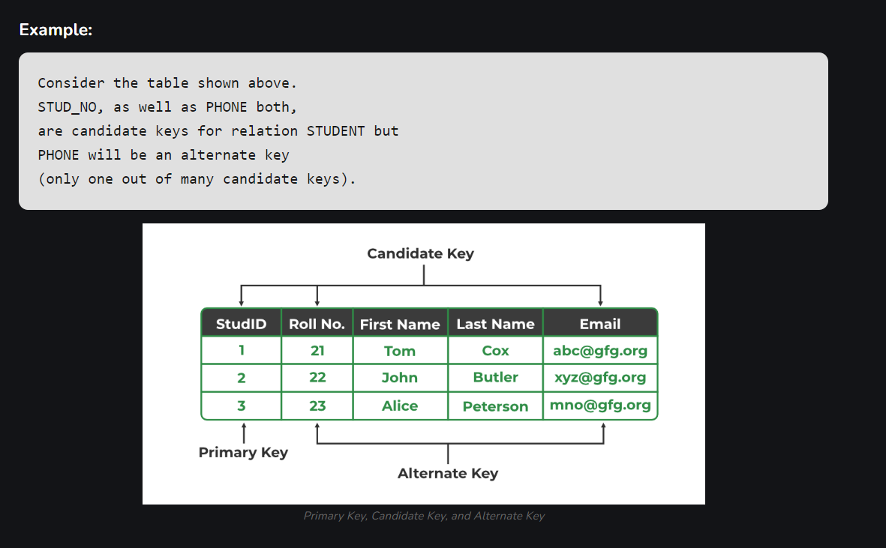

Slide 27
Foreign Key
If an attribute can only take the values which are present as values of some other attribute, it will be a foreign key to the attribute to which it refers. The relation which is being referenced is called referenced relation and the corresponding attribute is called referenced attribute. The referenced attribute of the referenced relation should be the primary key to it.
It is a key it acts as a primary key in one table and it acts as secondary key in another table.
It combines two or more relations (tables) at a time.
They act as a cross-reference between the tables.
For example, DNO is a primary key in the DEPT table and a non-key in EMP

Slide 28
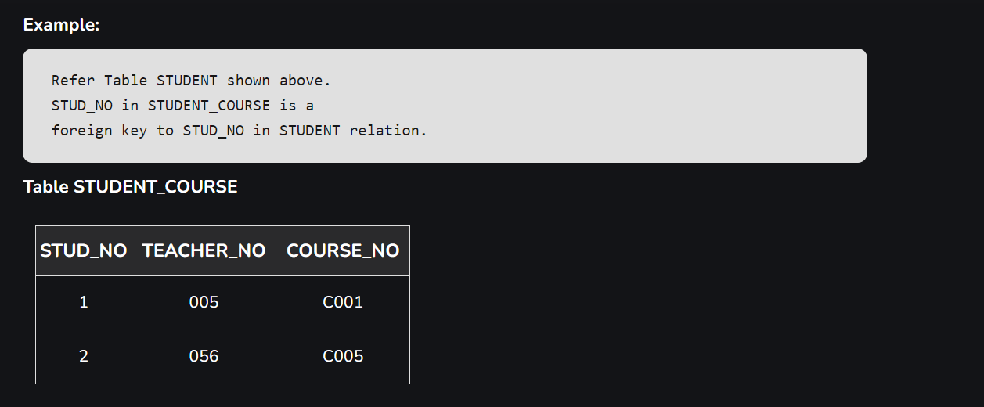

Slide 29
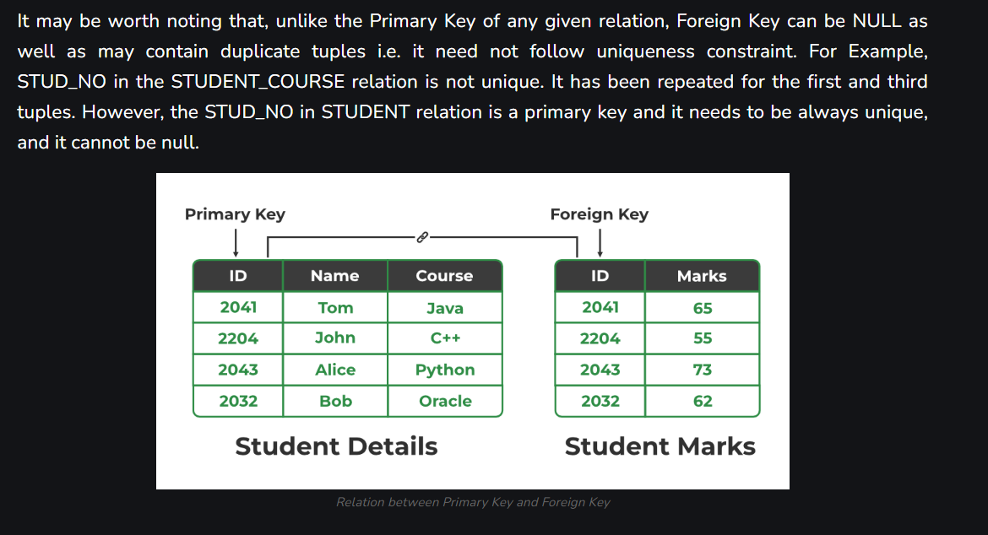

Slide 30
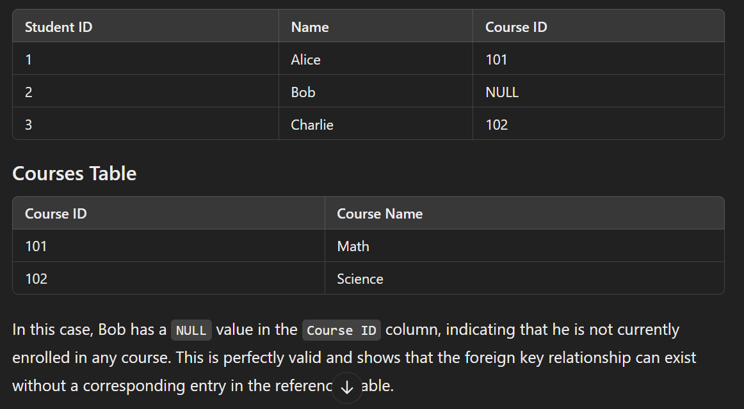
Example of foreign key with null values:

Slide 31
Composite Key
Sometimes, a table might not have a single column/attribute that uniquely identifies all the records of a table. To uniquely identify rows of a table, a combination of two or more columns/attributes can be used. It still can give duplicate values in rare cases. So, we need to find the optimal set of attributes that can uniquely identify rows in a table.
It acts as a primary key if there is no primary key in a table
Two or more attributes are used together to make a composite key .
Different combinations of attributes may give different accuracy in terms of identifying the rows uniquely.

Slide 32
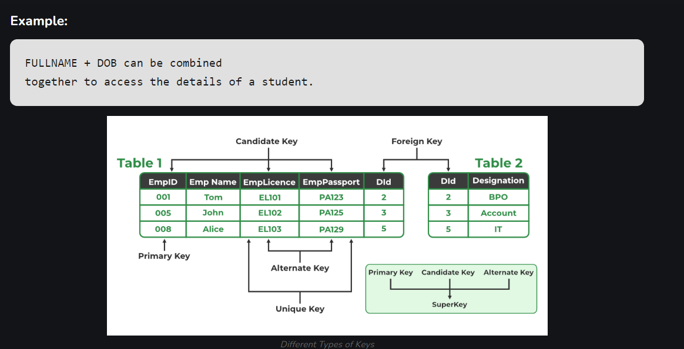

Slide 33
Oracle Data Types

Slide 34
Links
https://www.w3resource.com/oracle/oracle-data-types.php
https://www.w3schools.com/sql/sql_datatypes.asp

Slide 35
Most Frequently used data types:
Here are the most frequently used Oracle data types:
1. Numeric Types
NUMBER: For integer and decimal values. Commonly used for storing quantities, prices, etc. (e.g., NUMBER(10,2)).
2. Character Types
VARCHAR2: Variable-length string, commonly used for text fields (e.g., VARCHAR2(100)).
CHAR: Fixed-length string, useful for fields where the length is consistent (e.g., CHAR(10)).
3. Date and Time Types
DATE: Stores date and time values (e.g., DATE).
TIMESTAMP: For more precise date and time values, including fractional seconds.
4. Large Object Types
BLOB: For storing large binary data, like images or files.
CLOB: For storing large text data.

Slide 36
Getting started with SQL

Slide 37
SQL Commands | DDL, DQL, DML, DCL and TCL Commands
SQL commands are extensively used to interact with databases, enabling users to perform a wide range of actions on database systems. Understanding these commands is crucial for effectively managing and manipulating data.
This guide will introduce you to the various SQL sublanguage commands, including Data Definition Language (DDL), Data Query Language (DQL), Data Manipulation Language (DML), Data Control Language (DCL), and Transaction Control Language (T

Slide 38
Short Overview of SQL
Structured Query Language (SQL), as we all know, is the database language by which we can perform certain operations on the existing database, and we can also use this language to create a database. SQL uses certain commands like CREATE, DROP, INSERT, etc. to carry out the required tasks.
SQL Commands are like instructions to a table. It is used to interact with the database with some operations. It is also used to perform specific tasks, functions, and queries of data. SQL can perform various tasks like creating a table, adding data to tables, dropping the table, modifying the table, set permission for users.

Slide 39
SQL Commands
SQL Commands are mainly categorized into five categories:
DDL – Data Definition Language
DQL – Data Query Language
DML – Data Manipulation Language
DCL – Data Control Language
TCL – Transaction Control Language

Slide 40
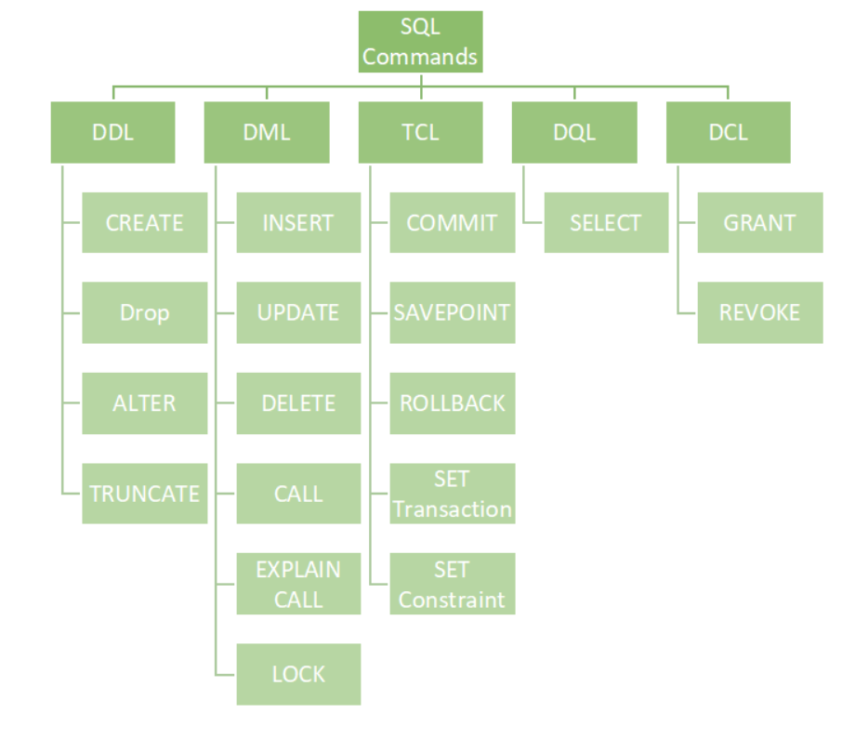

Slide 41
Data Definition Language

Slide 42
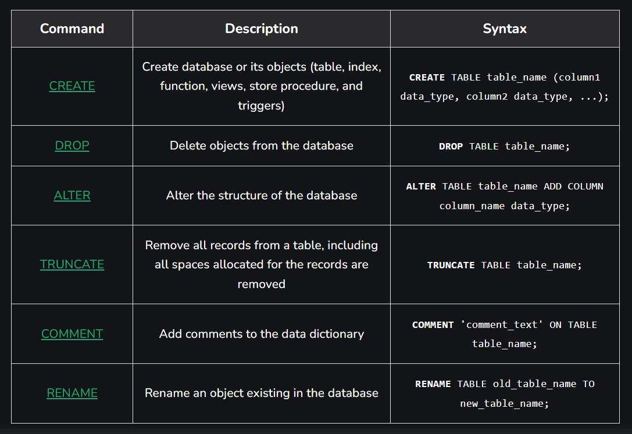
List of DDL Commands:

Slide 43
Naming Convention:
Case Sensitivity:
By default, unquoted names are stored in uppercase (e.g., first_name becomes FIRST_NAME).
For mixed or lowercase names, use double quotes (e.g., "first_name"), but this is discouraged.
Best Practices:
Use Uppercase: Commonly used for clarity since Oracle converts unquoted names to uppercase.
Use Underscores: Separate words with underscores for better readability (e.g., employee_id, first_name).
Avoid Special Characters: Stick to alphanumeric characters and underscores; avoid spaces and special characters.
Be Descriptive: Choose meaningful names that clearly describe the data (e.g., salary, date_of_birth).

Slide 44
CREATE COMMAND

Slide 45
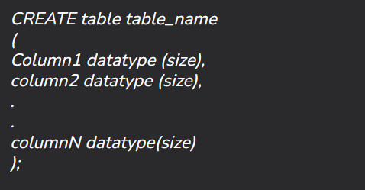
Syntax

Slide 46
CREATE COMMAND - CONSTRAINTS

Slide 47
CREATE – PRIMARY KEY CONSTRAINT
CREATE TABLE Employee (
EmployeeID INT PRIMARY KEY,
FirstName VARCHAR(50),
LastName VARCHAR(50),
Department VARCHAR(50),
Salary DECIMAL(10, 2)
);

Slide 48
CREATE - NOT NULL CONSTRAINT
CREATE TABLE Employee (
EmployeeID INT PRIMARY KEY,
FirstName VARCHAR(50) NOT NULL,
LastName VARCHAR(50) NOT NULL,
Department VARCHAR(50) NOT NULL,
Salary DECIMAL(10, 2) NOT NULL
);

Slide 49
What is varchar(50)?
Explanation:
VARCHAR: This data type stands for "variable character." It allows you to store strings of varying lengths.
(50): The 50 indicates that the maximum length of the string can be up to 50 characters. If you attempt to insert a string longer than 50 characters, Oracle will return an error.
For example:
A string like "Alice" (5 characters) will fit in a VARCHAR(50).
A string like "This string is longer than fifty characters..." will not fit and will cause an error if it's longer than 50 characters.
Using VARCHAR helps optimize storage, as it only uses as much space as needed for the actual string, up to the defined maximum.
Max limit of varchar is 4000.

Slide 50
CREATE – UNIQUE CONSTRAINT:
1. What is a Unique Constraint?
Ensures that all values in a column (or a combination of columns) are unique across rows.
Prevents duplicate entries in specified columns.
2. How to Define a Unique Constraint in SQL
Example Table Creation:
CREATE TABLE Employee ( EmployeeID INT PRIMARY KEY,
FirstName VARCHAR2(50) NOT NULL,
LastName VARCHAR2(50) NOT NULL,
Department VARCHAR2(50) NOT NULL,
Salary DECIMAL(10, 2) NOT NULL,
Email VARCHAR2(100) UNIQUE );

Slide 51
UNIQUE CONSTRAINT ON MULTIPLE COLUMNS
INLINE
END OF DEFINITION

Slide 52
Defining Unique Constraints on Multiple Columns:
CREATE TABLE Employee ( EmployeeID INT PRIMARY KEY,
FirstName VARCHAR2(50) NOT NULL,
LastName VARCHAR2(50) NOT NULL,
Department VARCHAR2(50) NOT NULL,
Salary DECIMAL(10, 2) NOT NULL,
UNIQUE (FirstName, LastName) );

Slide 53
Inline Unique Constraint
When you specify the unique constraint inline with the columns, you clearly indicate which columns are part of that constraint right where the columns are defined. This can improve readability and make it easier to understand the structure of the table at a glance.
CREATE TABLE Employee (
EmployeeID INT PRIMARY KEY,
FirstName VARCHAR2(50) NOT NULL,
LastName VARCHAR2(50) NOT NULL,
Department VARCHAR2(50) NOT NULL,
Salary DECIMAL(10, 2) NOT NULL,
Email VARCHAR2(100) UNIQUE,
Phone VARCHAR2(15) UNIQUE
);

Slide 54
End-of-Definition Unique Constraint
Placing the unique constraint at the end allows for a cleaner separation of column definitions and constraints. This approach can be useful if you have multiple constraints to define and want to keep the main structure of the table focused on the columns themselves.
CREATE TABLE Employee (
EmployeeID INT PRIMARY KEY,
FirstName VARCHAR2(50) NOT NULL,
LastName VARCHAR2(50) NOT NULL,
Department VARCHAR2(50) NOT NULL,
Salary DECIMAL(10, 2) NOT NULL,
UNIQUE (FirstName, LastName),
UNIQUE (Email)
);

Slide 55
CREATE - FOREIGN KEY CONSTRAINT
Establishes a relationship between two tables, ensuring that the value in one table corresponds to a valid value in another.
FOREIGN KEY (DepartmentID) REFERENCES Departments(DepartmentID)

Slide 56
CREATE - CHECK CONSTRAINT
Ensures that the values in a column satisfy a specific condition.
CHECK (Salary > 0)

Slide 57
CHECK CONTRAINT - EXAMPLE
CREATE TABLE Employee (
EmployeeID INT PRIMARY KEY,
FirstName VARCHAR2(50) NOT NULL,
LastName VARCHAR2(50) NOT NULL,
Salary DECIMAL(10, 2) CHECK (Salary > 0)
);
In this example, the CHECK constraint ensures that any salary entered must be greater than zero.

Slide 58
INSERTING INVALID DATA: CHECK CONSTRAINT
If you try to insert a record with a negative salary:
INSERT INTO Employee (EmployeeID, FirstName, LastName, Salary)
VALUES (1, 'Alice', 'Smith', -5000);
Result:
The database will reject the insert operation and return an error message similar to:

Slide 59
EXAMPLE OF A CREATE TABLE STATEMENT WITH CONSTRAINTS
CREATE TABLE Employee (
EmployeeID INT PRIMARY KEY,
FirstName VARCHAR2(50) NOT NULL,
LastName VARCHAR2(50) NOT NULL,
DepartmentID INT,
Email VARCHAR2(100) UNIQUE,
Salary DECIMAL(10, 2) CHECK (Salary > 0),
FOREIGN KEY (DepartmentID) REFERENCES Departments(DepartmentID)
);

Slide 60
DDL – DROP & TRUNCATE

Slide 61
DROP and TRUNCATE
DROP and TRUNCATE in SQL remove data from the table. The main difference between DROP and TRUNCATE commands in SQL is that DROP removes the table or database completely, while TRUNCATE only removes the data, preserving the table structure.

Slide 62
What is DROP Command?
DROP command in SQL is used to delete a whole database or a table.
DROP statement deletes objects like an existing database, table, index, or view.
Syntax
DROP object object_name ;

Slide 63
DROP Command Examples
DROP Table
Syntax
DROP TABLE table_name;
DROP database
Syntax:
DROP DATABASE database_name;

Slide 64
What is TRUNCATE Command?
TRUNCATE statement is a Data Definition Language (DDL) operation that is used to mark the extent of a table for deallocation (empty for reuse). The result of this operation quickly removes all data from a table, typically bypassing several integrity-enforcing mechanisms.
Syntax
TRUNCATE TABLE table_name;

Slide 65
References:
https://www.geeksforgeeks.org/types-of-keys-in-relational-model-candidate-super-primary-alternate-and-foreign/
https://www.geeksforgeeks.org/sql-ddl-dql-dml-dcl-tcl-commands/
https://www.w3resource.com/oracle/oracle-data-types.php
https://www.w3schools.com/sql/sql_datatypes.asp

